Slide 1
DIABETIC
KETOACIDOSIS
CLINICAL
RUTO BSC.

Slide 2
CONTENTS
DEFINITION
EPIDEMIOLOGY
MECHANISM
PATHOPHYSIOLOGY
INITIATING FACTORS
SIGN AND SYMPTOMS
DIAGNOSIS
TREATMENT
CASE REPORT

Slide 3
DEFINITION:
It is a state of absolute or relative insulin deficiency aggravated by ensuing hyperglycemia,dehydration & acidosis .It is a medical emmergency.DKA is far more characteristic feature of type 1 Diabetes mellitus than of type 2 Diabetes mellitus.

Slide 4
LAB DEFINITION:
Blood glucose level > 250 mg/dl
Blood pH < 7.3
Ketones in serum > 5 m.eq/L

Slide 5
MECHANISM:
A; The basic underlying mechanisms are:
Absolute deficiency of circulating insulin.
secretion of insulin counterregulatory hormones; glucagon, adrenaline, cortisol and growth hormone.

Slide 6
B-This leads to disturbances in the following physiological processes:
-glucose utilization (hyperglycemia).
- proteolysis ( amino acids, glutamine and alanine).
- lipolysis ( glycerol and FFAs).
- glycogenolysis (breakdown of muscle glycogen lactate).
- gluconeogensis (glutamine & alanine & glycerol & lactate are the precursors).

Slide 7
PATHOPHYSIOLOGY
1:HYPERGLYCEMIA:
Serum osmolality → insulin resistance increases → hyperglycemia worsens.
2:ACIDOSIS:
Decrease insulin → increase lipolysis → ketone bodies → ketonemia → ketone anions→ depletes alkali reserves → kussmaul respiration.
3:DEHYDRATION:

Slide 8
Hyperglycemia → hyperosmolality → increase urination
Nausea and vomiting → further water loss
Decrease renal blood flow → GFR decrease
Hypovolumic shock
4:ELECTROLYTE IMBALANCE
Loss of potassium
Blood urea nitrogen

Slide 9
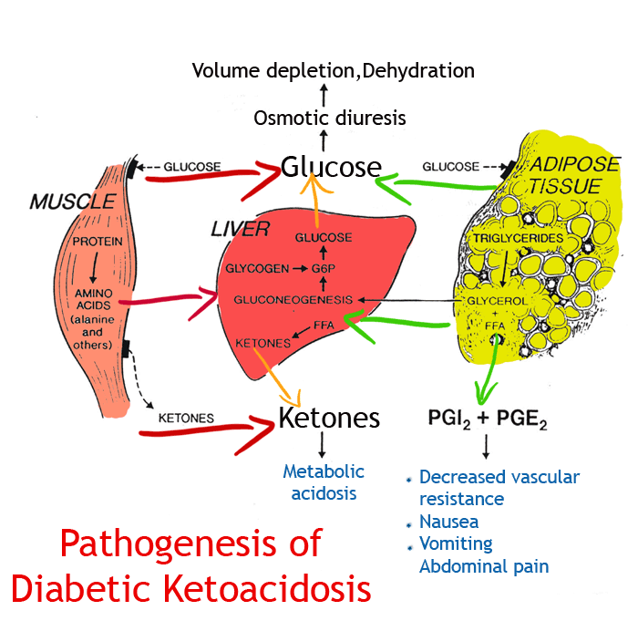

Slide 10
INITIATING OR TRIGGERING FACTORS:
Infection
Pneumonia & UTI most commonly
Inadequate use of insulin
Not taking insulin.

Slide 11
Emotional stress
Drugs:
Corticosteroids
Antihistamines
Thiazide Diuretics
Pancreatitis

Slide 12
CLINICAL FEATURES OF DKA:
A-Symptoms of DKA:
1-Classic symptoms of hyperglycemia:
Polyuria, polydipsia, weight loss and thirst.
2-Other symptoms:
- General weakness, malaise and lethargy.
-Nausea, vomiting and abdominal pain.
- Perspiration.
- Disturbed consciousness and confusion.
3-Symptoms of underlying infections or other conditions; fever, abdominal pain, dysuria, chest pain…etc

Slide 13
PHYSICAL SIGNS OF DKA:
.
a-Signs of dehydration:
-Skin: Dry, hot, flushed, and loss of skin turgor.
-Tongue: Dry (sometimes woody tongue).
-Eyes: Sunken eyes and dark circles under the eyes.
b-Vital signs:
-Tachycardia, hypotension and tachypnea.
c-Specific signs:
-Ketotic breath: A strong, fruity breath odour (similar to nail polish remover or acetone).
-Acidotic breath (Kussmaul's respiration): deep and rapid.
-Abdominal tenderness.

Slide 14
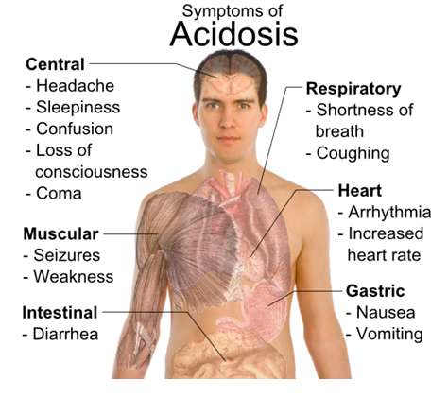

Slide 15
DIAGNOSIS:
You should suspect DKA if a diabetic patient presents with:
Dehydration.
Acidotic (Kussmaul’s) breathing, with a fruity smell (acetone).
Abdominal pain &\or distension.
Vomiting.
An altered mental status ranging from disorientation to coma.

Slide 16
MANAGEMENT:
The main lines of management include:
A-Primary assessment:
-Volume status and degree of dehydration.
-Blood pressure and cardiac condition.
-Degree of consciousness.
-Degree of acidosis.
-Precipitating disease

Slide 17
ONGOING MONITORING:
-Blood glucose (using glucometers) every hour.
-Electrolytes and pH every 4 hours.
-Urine for glucose and ketones every 4 hours

Slide 18
INITIATION OF TREATMENT:
1-General measures:
-Airway and O2 inhalation if needed.
-IV line.
-Urinary Foley's catheter (if in shock).
-NGT (Nasogastric Tube): to avoid gastric dilatation and protection from aspiration .
-Thrombosis prophylaxis: 5000 units of heparin SC/12 hours.
-Empiric use of 3rd generation cephalosporin antibiotics.

Slide 19
2-Specific measures:
Successful therapy of hyperglycemic crises requires the administration of:
a-Fluids:
1- Correct volume deficit and hypotension.
2- Improve tissue perfusion.
3-Improve glomerular filtration rate:
i-↑ excretion of large amount of glucose in urine.
ii-Clears hyperketonemia.
4- Correct metabolic acidosis.

Slide 20
b-Insulin: Reversal of metabolic abnormalities :
i-Corrects hyperglycemia.
ii-Inhibits ketogenesis.
c-Potassium: Prevents complications associated with hypokalemia.

Slide 21
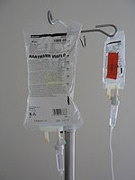
FLUID THERAPY:
The expected volume deficits calculated as:
5-10% of body wt in DKA (3-6 liters).
Replacement therapy should be given within 24 hours after admission:
50% of the deficit in the first 4 hours.
50% of the deficit in the next time for up to 24 hours, guided by ongoing clinical evaluation.
For children and adolescents (less than 20 years):
Fluids are given as 10-20 ml/kg/hour in the first four hours.
Then given guided by clinical evaluation

Slide 22
TYPE OF FLUID THERAPY:
1-Normal saline (0.9% sodium chloride).
Advantages:
-Available all the time.
-Rapid expansion of extracellular compartment.
-Slow decline of extracellular osmolarity.
-Slow rate of cerebral edema evolution.
Disadvantages: May accentuate hypernatrimia if present.
Indications:
-All cases of DKA.
-Initial (1st 2 liters) in NKHH state.

Slide 23
INSULIN THERAPY:
Standard low dose insulin regimen: This regimen is the only effective therapy in DKA & NKHH state:
1-Inhibits ketogenesis and gluconeogenesis.
2- Presence of insulin resistance state secondary to:
a- Stress insulin counterregulatory hormones.
b- Ketone bodies & FFAs.
c- Hemoconcentration and electrolytes imbalance.
d- Hyperosmolarity.
e- Infection.

Slide 24
Type of insulin : Regular : Rapid or short acting insulin U-40 & U-100.
Regimen:
Initial bolus: 0.1 U/kg body wt given IV.
Maintenance: 0.1 U/kg/body wt /hour:
a- IV Infusion set: Add 100 units of regular insulin +500 ml saline i.e. every 5 cc fluid contains 1 unit of insulin
b-IV infusion set is not available:IM route.

Slide 25
POTASSIUM THERAPY:
Initially: Mild to moderate hypokalemia occur in patients with DKA.
Later on: After initiation of Insulin therapy Correction of acidosis lead to hypokalemia.
Volume expansion & hydration

Slide 26
Monitoring:
Blood glucose by glucometer every hour.
Urine analysis for glucose and ketones every 4 hours.
Order IV glucose 5% (second line) once blood glucose reaches:
< 250 mg/ dl in DKA.
< 300 mg/ dl in NKHH state.
Re-evaluate parameters of rehydration establishment:
Stable blood pressure.
Normal urine output.
Clinical signs of rehydration.

Slide 27
Evaluate the criteria for stopping hourly insulin regimen (resolving DKA):
Acidosis corrected clinically and by pH.
Negative ketoneuria.
Eating.
Patient looks good and feels good.

Slide 28
COMPLICATIONS
1-Complications of associated illnesses e.g. sepsis or MI.
2-Adult respiratory distress syndrome.
3-Thromboembolism (elderly).
4-Complications of treatment:
a-Hypokalemia: Which may lead to:
-Cardiac arrhythmias.
-Cardiac arrest.
-Respiratory muscle weakness.

Slide 29
b-Hypoglycemia.
c-Overhydration and acute pulmonary edema: particularly in:
-Treating children with DKA.
-Adults with compromised renal or cardiac function.
-Elderly with incipient CHF.

Slide 30
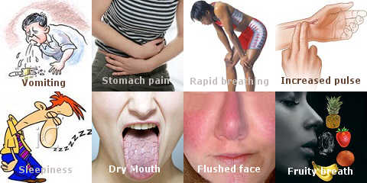
DIABETIC KETOACIDOSIS:

